Slide 1

Arrays
Ahmed Kamal Manar Yousry

Slide 2
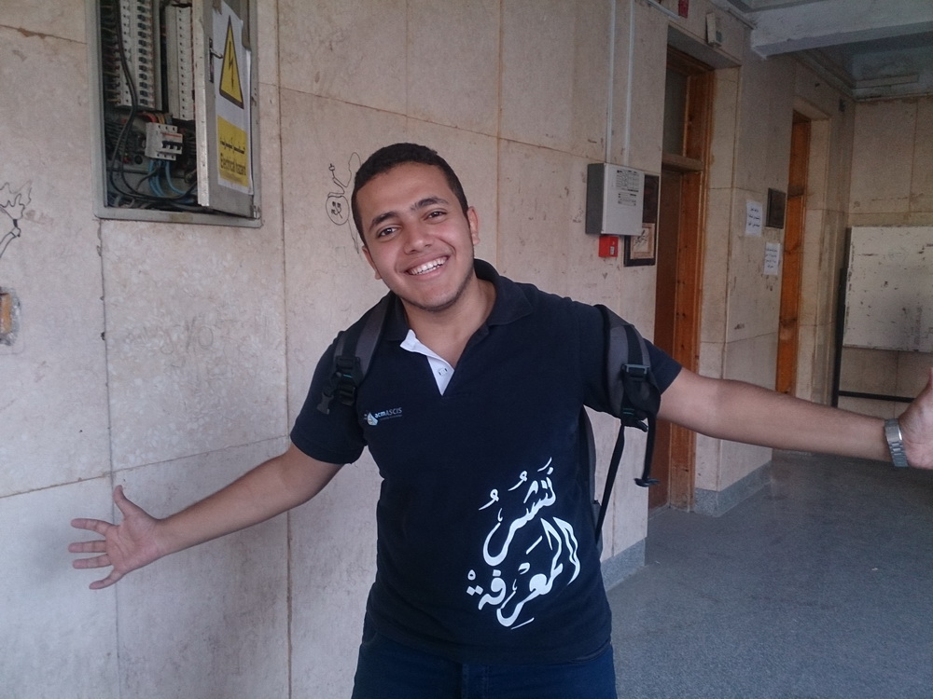

Slide 3
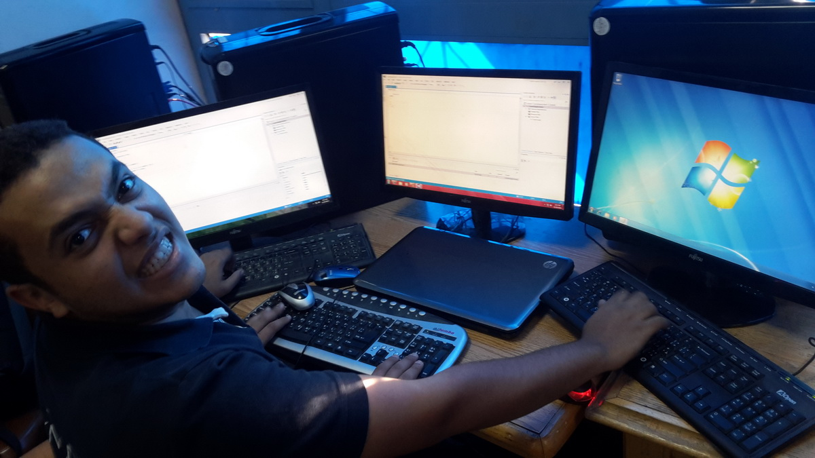

Slide 4
int student1;
int student7;
int student13;
int student19;
int student2;
int student8;
int student14;
int student20;
int student3;
int student9;
int student15;
int student21;
int student4;
int student10;
int student16;
int student22;
int student5;
int student11;
int student17;
int student23;
int student6;
int student12;
int student18;
int student24;

Slide 5
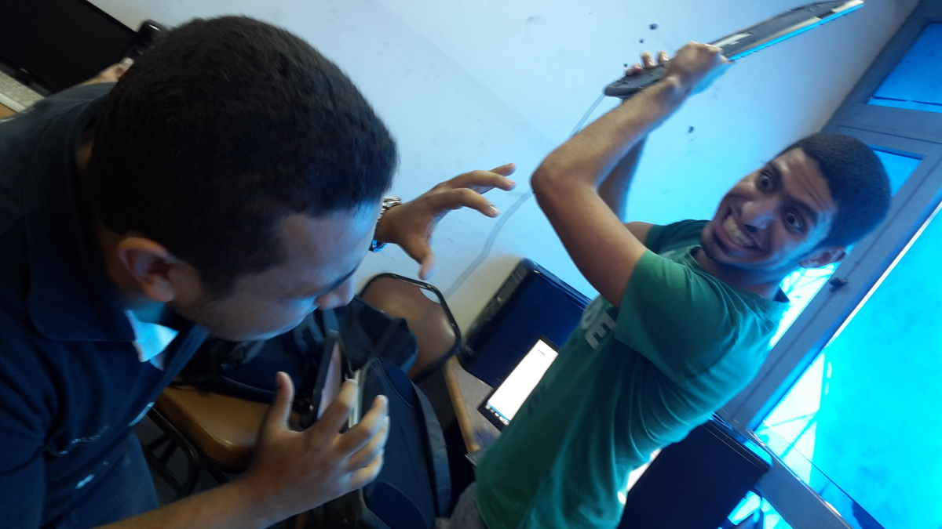

Slide 6
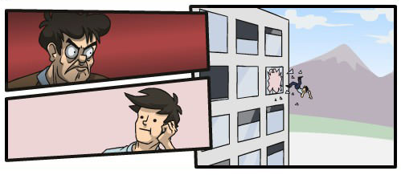
comic

Slide 7
Arrays !!

Slide 8
What is an array ?
Memory
Address | Value
…
100
101
…
300
301
302
303
…
…
An Array is a block of contagious variables in memory that are given a name as a block.
Arrays can be of any data type, even arrays of arrays.

Slide 9
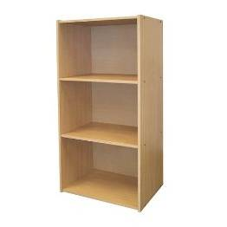

Slide 10
Declaration
Memory
Address | Value
100 | ??
101 | ??
102 | ??
103 | ??
104 | ??
105
…
salaries
Datatype ArrayName[Size];
int salaries[5];
double marks[3];
char name[4];

Slide 11
Array elements
int arr[5];
Index
Value
To access an array element, use [ ] after array name.
0
1
2
3
4
Index
Example:
15
arr[2] = 15;
size - 1

Slide 12
cin and cout
int arr[5];
Index
Value
0
1
2
3
4
cin >> arr[2]; //Entered 17
17
cout << arr[2];
// 17 displayed on console
Notes:
Ba3d ma n5allas el slides deh, han2olohom law 3ayzen nemla array be arkam {3, 1, 20, 11, 5}…we n2olohom momken n3mel arr[0] = 2 we arr[1] = 1 wa hakza…we n2olhom en fe beter solution elly hwa el composite initialization…we n2leb el slide

Slide 13
Initialization
Composite Initialization
Initialize an array of 5 integers.
int numbers[5] = {3, 1, 20, 11, 5}; // 3, 1, 20, 11, 5
int numbers[] = {3, 1, 20, 11, 5}; // 3, 1, 20, 11, 5
int sequence[5] = {1, 2}; // 1, 2, 0, 0, 0
int zeroArray[5] = {}; // 0, 0, 0, 0, 0

Slide 14
Game

Slide 15
Accessing Elements
Index
Value
int numbers[5];
0
1
2
3
4
3
numbers[3] = 11;
numbers[1] = 1;
1
numbers[4] = 5;
20
numbers[0] = 3;
11
numbers[2] = 20;
cin >> numbers[5];
5

Slide 16


Slide 17
Common Errors and Mistakes

Slide 18


Access Violation Exception
int arr[5];
arr[4] = 11;
arr[5] = 11;
Notes:
The indexes of an array of size N are integers between [0, N-1].
arr[0] is the first element and arr[N-1] is the last element.
arr[N] isn’t reserved by the array. You cannot assign values to it. Any attempt to assign values to it will result an Exception.

Slide 19
Huge Size
The size of the array should be around 1 MB. Usually if the size is larger than that, the program will CRASH !
int arr[1000000];
// 1000000*4 ~ 4 MB
int arr[100000];
// 100000*4 ~ 400 KB
int arr[250000];
// 250000*4 ~ 1 MB
char arr[1000000];
// 1000000*1 ~ 1 MB

Slide 20
Any Questions ?

Slide 21
Reading and Writing arrays

Slide 22
Loops in action
Index
Value
0
1
2
3
4
for (int i = 0; i < size; i++) //size = 5
{
cin >> arr[i];
}

Slide 23
Loops in action
i=0
Index
Value
0 < 5
0
1
2
3
4
7
for (int i = 0; i < size; i++) //size = 5
{
cin >> arr[i]; // Input: 7
}

Slide 24
Loops in action
i=1
Index
Value
1 < 5
0
1
2
3
4
7
for (int i = 0; i < size; i++) //size = 5
{
cin >> arr[i]; // Input: -5
}
-5

Slide 25
Loops in action
i=2
Index
Value
2 < 5
0
1
2
3
4
7
for (int i = 0; i < size; i++) //size = 5
{
cin >> arr[i]; // Input: 3
}
-5
3

Slide 26
Loops in action
i=3
Index
Value
3 < 5
0
1
2
3
4
7
for (int i = 0; i < size; i++) //size = 5
{
cin >> arr[i]; // Input: 1
}
-5
3
1

Slide 27
Loops in action
i=4
Index
Value
4 < 5
0
1
2
3
4
7
for (int i = 0; i < size; i++) //size = 5
{
cin >> arr[i]; // Input: 10
}
-5
3
1
10

Slide 28
Loops in action
i=5
Index
Value
5 < 5
0
1
2
3
4
7
for (int i = 0; i < size; i++) //size = 5
{
cin >> arr[i]; // Input: 10
}
-5
3
1
10

Slide 29
Loops in action
for (int i = 0; i < size; i++)
{
cout << arr[i] << endl;
}

Slide 30
Let’s practice !
Given an array of integers “numbers” that have the numbers {1, 5, 8, 2, 3, 4, 13}, write a program to count the even numbers.

Slide 31
int numbers[] = {1, 5, 8, 2, 3, 4, 13}; int counter = 0; for (int i = 0; i < 7; i++)
{
if (numbers[i] % 2 == 0) counter++;
}
cout << counter << endl;

Slide 32
int numbers[] = {1, 5, 8, 2, 3, 4, 13}; int counter = 0; for (int i = 0; i < 7; i++)
{
if (numbers[i] % 2 == 0) counter++;
}
cout << counter << endl;
Counter=0
i=0

Slide 33
int numbers[] = {1, 5, 8, 2, 3, 4, 13}; int counter = 0; for (int i = 0; i < 7; i++)
{
if (numbers[i] % 2 == 0) counter++;
}
cout << counter << endl;
Counter=0
i=1

Slide 34
int numbers[] = {1, 5, 8, 2, 3, 4, 13}; int counter = 0; for (int i = 0; i < 7; i++)
{
if (numbers[i] % 2 == 0) counter++;
}
cout << counter << endl;
Counter=1
i=2

Slide 35
int numbers[] = {1, 5, 8, 2, 3, 4, 13}; int counter = 0; for (int i = 0; i < 7; i++)
{
if (numbers[i] % 2 == 0) counter++;
}
cout << counter << endl;
Counter=2
i=3

Slide 36
int numbers[] = {1, 5, 8, 2, 3, 4, 13}; int counter = 0; for (int i = 0; i < 7; i++)
{
if (numbers[i] % 2 == 0) counter++;
}
cout << counter << endl;
Counter=2
i=4

Slide 37
int numbers[] = {1, 5, 8, 2, 3, 4, 13}; int counter = 0; for (int i = 0; i < 7; i++)
{
if (numbers[i] % 2 == 0) counter++;
}
cout << counter << endl;
Counter=3
i=5

Slide 38
int numbers[] = {1, 5, 8, 2, 3, 4, 13}; int counter = 0; for (int i = 0; i < 7; i++)
{
if (numbers[i] % 2 == 0) counter++;
}
cout << counter << endl;
Counter=3
i=6

Slide 39
Any Questions ?

Slide 40
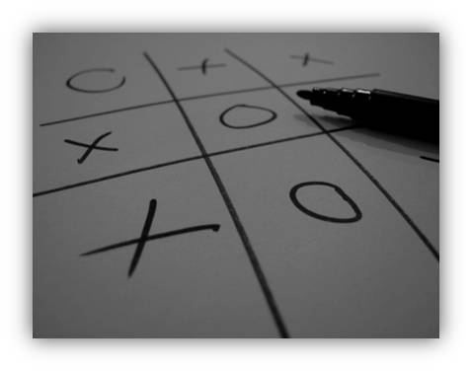

Slide 41
X
O
X
X
O
X
O
O
Who is the winner ??

Slide 42
O is the winner
X | O | X
X | O | X
O | O

Slide 43
char row1[3];
X | O | X
char row2[3];
X | O | X
char row3[3];
O | O

Slide 44
char row1[8];
char row2[8];
What if we have a chess board ?
char row3[8];
char row4[8];
char row5[8];
char row6[8];
char row7[8];
char row8[8];

Slide 45
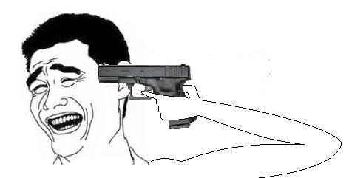

Slide 46
Too many variables
Array
Too many arrays
Array of array !

Slide 47
2-D Array !

Slide 48
Declaration
Columns
0 1 2 3 4 5 6 7
Array
0
1
2
3
4
5
6
7
char chessBoard[8] [8];
S
Array of array 2D array
Rows
chessBoard[1][2] = ‘S’;

Slide 49
Reading and writing 2-D arrays
Reading an array
Loop
Reading an array of array
Nested Loop !

Slide 50
Reading and writing 2-D arrays
int Array[3][3];
0,0 | 0,1 | 0,2
1,0 | 1,1 | 1,2
2,0 | 2,1 | 2,2
for (int i = 0; i < 3; i++)
{
for (int j = 0; j < 3; j++)
{
cin >> Array[i][j];
}
}

Slide 51
Reading and writing 2-D arrays
int Array[3][3];
0,0 15 | 0,1 | 0,2
1,0 | 1,1 | 1,2
2,0 | 2,1 | 2,2
i=o , j=0
for (int i = 0; i < 3; i++)
{
for (int j = 0; j < 3; j++)
{
cin >> Array[i][j];
}
}
// Input: 15

Slide 52
Reading and writing 2-D arrays
int Array[3][3];
0,0 15 | 0,1 -31 | 0,2
1,0 | 1,1 | 1,2
2,0 | 2,1 | 2,2
i=o , j=1
for (int i = 0; i < 3; i++)
{
for (int j = 0; j < 3; j++)
{
cin >> Array[i][j];
}
}
// Input: -31

Slide 53
Reading and writing 2-D arrays
int Array[3][3];
0,0 15 | 0,1 -31 | 0,2 0
1,0 | 1,1 | 1,2
2,0 | 2,1 | 2,2
i=o , j=2
for (int i = 0; i < 3; i++)
{
for (int j = 0; j < 3; j++)
{
cin >> Array[i][j];
}
}
// Input: 0

Slide 54
Reading and writing 2-D arrays
int Array[3][3];
0,0 15 | 0,1 -31 | 0,2 0
1,0 6 | 1,1 | 1,2
2,0 | 2,1 | 2,2
i=1 , j=0
for (int i = 0; i < 3; i++)
{
for (int j = 0; j < 3; j++)
{
cin >> Array[i][j];
}
}
// Input: 6

Slide 55
Reading and writing 2-D arrays
int Array[3][3];
0,0 1 | 0,1 2 | 0,2 3
1,0 4 | 1,1 5 | 1,2
2,0 | 2,1 | 2,2
0,0 15 | 0,1 -31 | 0,2 0
1,0 6 | 1,1 9 | 1,2
2,0 | 2,1 | 2,2
i=1 , j=1
for (int i = 0; i < 3; i++)
{
for (int j = 0; j < 3; j++)
{
cin >> Array[i][j];
}
}
// Input: 9

Slide 56
Reading and writing 2-D arrays
int Array[3][3];
0,0 15 | 0,1 -31 | 0,2 0
1,0 6 | 1,1 9 | 1,2 -1
2,0 | 2,1 | 2,2
i=1 , j=2
for (int i = 0; i < 3; i++)
{
for (int j = 0; j < 3; j++)
{
cin >> Array[i][j];
}
}
// Input: -1

Slide 57
Reading and writing 2-D arrays
int Array[3][3];
0,0 15 | 0,1 -31 | 0,2 0
1,0 6 | 1,1 9 | 1,2 -1
2,0 7 | 2,1 | 2,2
i=2 , j=0
for (int i = 0; i < 3; i++)
{
for (int j = 0; j < 3; j++)
{
cin >> Array[i][j];
}
}
// Input: 7

Slide 58
Reading and writing 2-D arrays
int Array[3][3];
0,0 15 | 0,1 -31 | 0,2 0
1,0 6 | 1,1 9 | 1,2 -1
2,0 7 | 2,1 10 | 2,2
i=2 , j=1
for (int i = 0; i < 3; i++)
{
for (int j = 0; j < 3; j++)
{
cin >> Array[i][j];
}
}
// Input: 10

Slide 59
Reading and writing 2-D arrays
int Array[3][3];
0,0 15 | 0,1 -31 | 0,2 0
1,0 6 | 1,1 9 | 1,2 -1
2,0 7 | 2,1 10 | 2,2 1324
i=2 , j=2
for (int i = 0; i < 3; i++)
{
for (int j = 0; j < 3; j++)
{
cin >> Array[i][j];
}
}
// Input: 1324

Slide 60
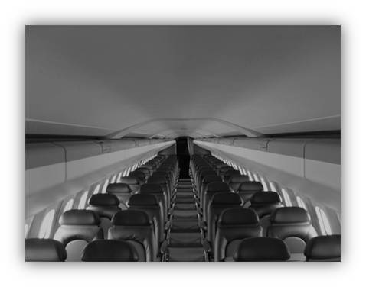
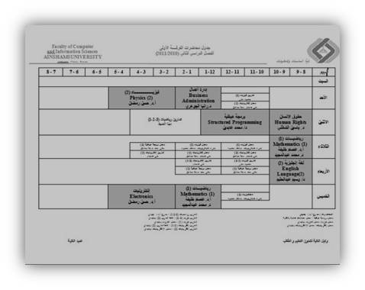

Applications about 2D Array

Slide 61
Visualization vs. Memory
char XOBoard[3][3];
Visualized
Memory
0,0
0,1
0,2
1,0
1,1
1,2
2,0
2,1
2,2
0,0 | 0,1 | 0,2
1,0 | 1,1 | 1,2
2,0 | 2,1 | 2,2

Slide 62
Any Questions ?

Slide 63
Thank you ☺

